Slide 1
Capstone project Traffic accidents
Tom van Eijk

Slide 2
Introduction
Many accidents in the Netherlands
Deadly
Since there are lots of regions in the Netherlands we will try to detect the locations where most fatal accidents happen. We are also particularly interested in areas with lower traffic accident rates to save advertisement costs on.

Slide 3

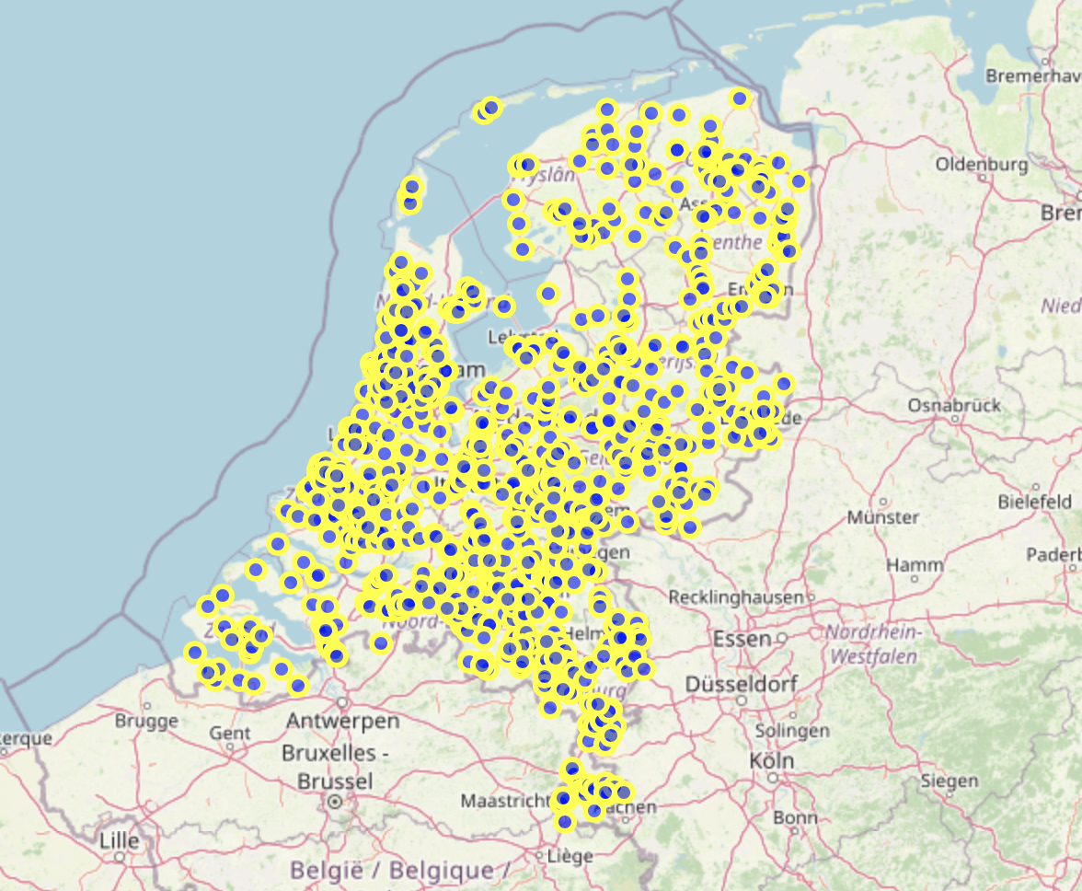
Data description
Data set of traffic accidents that happened in 2004
Open data source

Slide 4
Methodology
Distinction between non-deadly accidents and deadly incidents
coordinates and locations of this regions
machine learnings techniques such as SVM

Slide 5
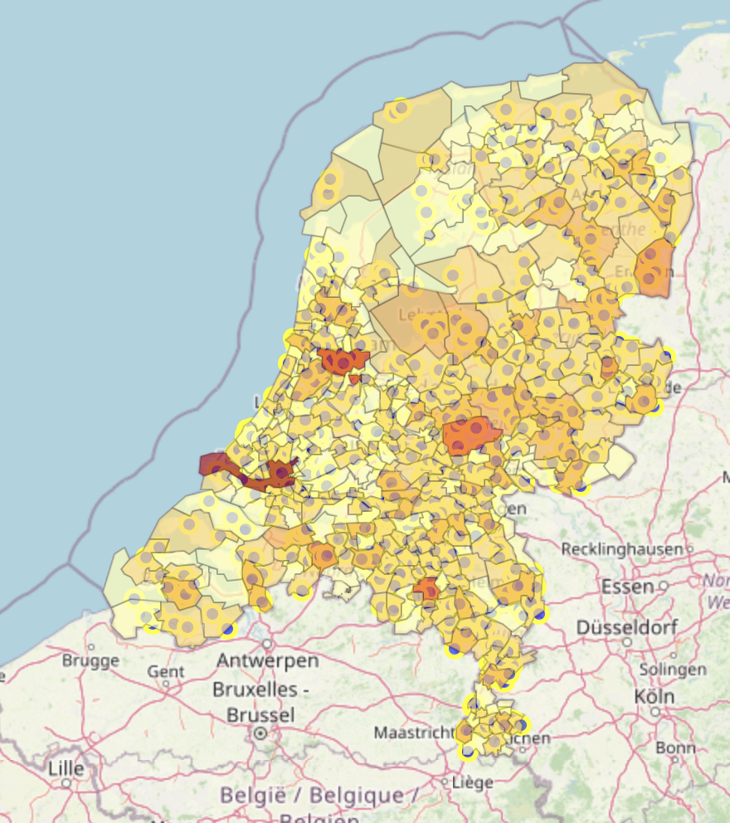
Results
Highest concentrated deadly accident regions were identified
One-hot coding
SVM classifier

Slide 6
Discussion
High accuracy
Rotterdam
Marketing plan

Slide 7
conclusion
Most dangerous regions
Re-run this data science program
Thank you for the opportunity

